Slide 1
Chapter 3: Processes

Slide 2
Chapter 3: Processes
Process Concept
Process Scheduling
Operations on Processes
Interprocess Communication
Examples of IPC Systems
Communication in Client-Server Systems

Slide 3
Process Concept
Process – a program in execution
Multiple parts
The program code, also called text section
Current activity including program counter, processor registers
Stack containing temporary data
Function parameters, return addresses, local variables
Data section containing global variables
Heap containing memory dynamically allocated during run time
Notes:
Process = program during run-time
Terminate when main function is over

Slide 4
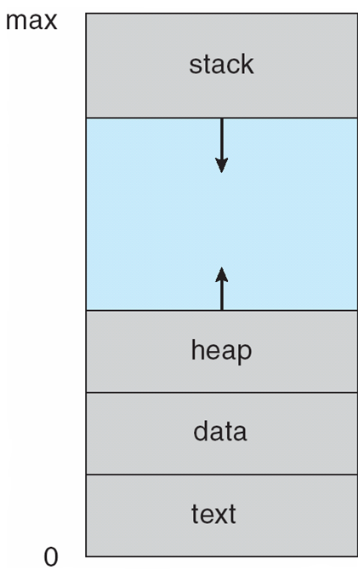
Process in Memory
Notes:
****most important picture in CS concepts. -- not just this class

Slide 5
Process State
As a process executes, it changes state
new: The process is being created
running: Instructions are being executed
waiting: The process is waiting for some event to occur
ready: The process is waiting to be assigned to a processor
terminated: The process has finished execution

Slide 6
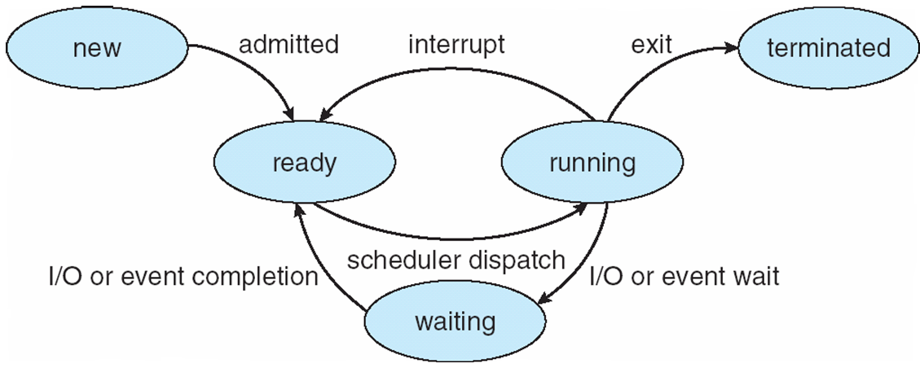
Diagram of Process State
Notes:
Ready – currently running on CPU
Scheduler dispatch – chose by CPU scheduler : timeslot
Interrupt – after running for x amount of time, CPU needs to process others
**exam

Slide 7
Seven State System - Stallings
dispatch
dispatch
admit
New
admit
release
New
Ready
Ready
Running
Running
Exit
Exit
timeout
activate
timeout
admit
suspend
event
occurs
event
occurs
event
wait
Suspended
Ready
event
wait
Suspended
Blocked
Blocked
program is
in memory
program is
in memory
event
occurs
activate
suspend
program is
on disk
Suspended
Blocked
Transition diagram of a seven-state model
Stallings, W. (2004) Operating Systems:
Internals and Design Principles (5th Edition).
Notes:
Running state = to # of cores

Slide 8
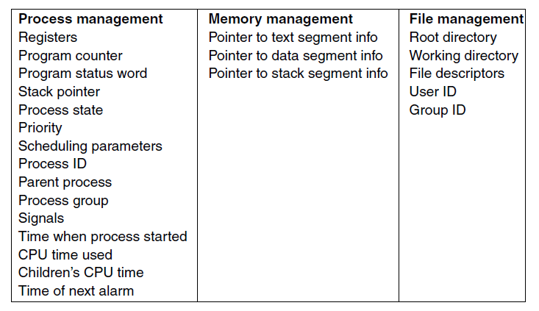
Process Control Block (PCB)
Some of the fields of a typical PCB entry.

Slide 9
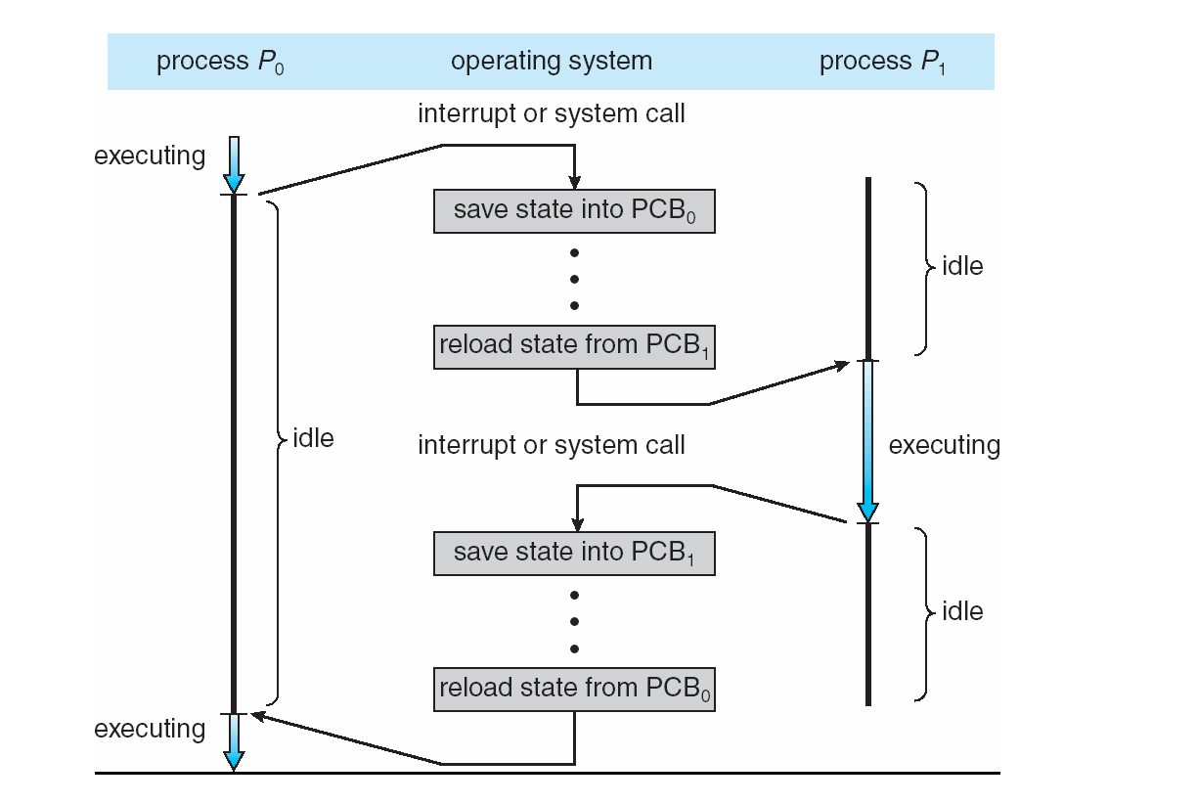
CPU Switch From Process to Process
Notes:
Timesharing mechanism

Slide 10
Threads
So far, process has a single thread of execution
Consider having multiple program counters per process
Multiple locations can execute at once
Multiple threads of control -> threads
Must then have storage for thread details, multiple program counters in PCB
More about this in the next chapter
Notes:
Single thread – sequential (one process after the other)
Multi-threading – every thread is a list of instructions to be executed at run-time
multiple run time environments = more run time stacks
STRUCT SLIDES:
All linked together, like linked list
ready queue, ready to be executed
doubly linked list

Slide 11
Process Scheduling
Maximize CPU use, quickly switch processes onto CPU for time sharing
Process scheduler selects among available processes for next execution on CPU
Maintains scheduling queues of processes
Job queue – set of all processes in the system
Ready queue – set of all processes residing in main memory, ready and waiting to execute
Device queues – set of processes waiting for an I/O device
Processes migrate among the various queues
Notes:
Process scheduler – decide which process is next for execution among all processes available
- one way: first come first serve
Job queue
Ready queue
Device queue

Slide 12
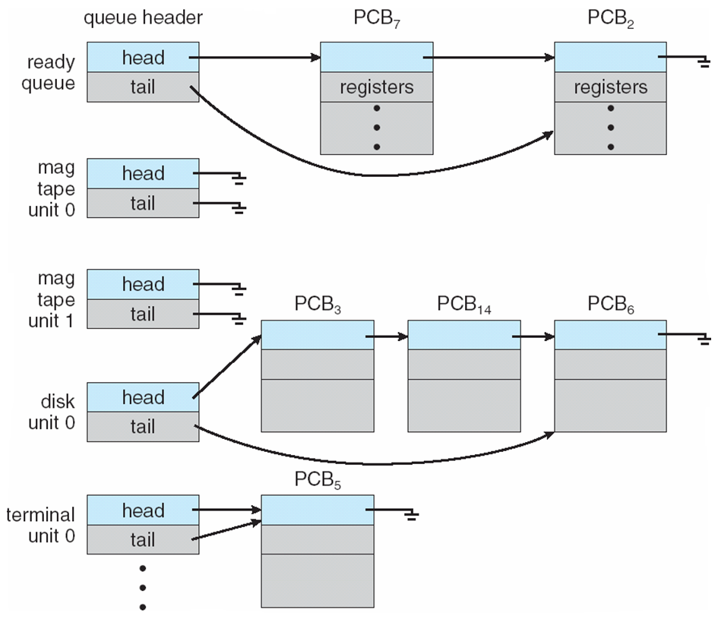
Ready Queue And Various I/O Device Queues

Slide 13
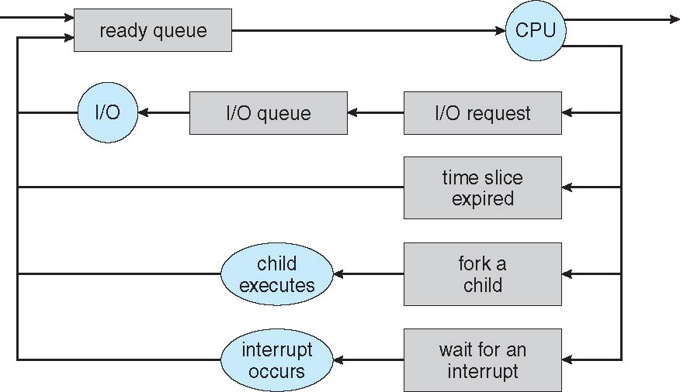
Representation of Process Scheduling
Queueing diagram represents queues, resources, flows
Notes:
5 states from kernel/system perspective
1 process can create a new process - ‘fork a child’ and parent process must wait for child to finish executing until it can continue on

Slide 14
Schedulers
Short-term scheduler (or CPU scheduler) – selects which process should be executed next and allocates CPU
Sometimes the only scheduler in a system
Short-term scheduler is invoked frequently (milliseconds) ⇒ (must be fast)
Long-term scheduler (or job scheduler) – selects which processes should be brought into the ready queue
Long-term scheduler is invoked infrequently (seconds, minutes) ⇒ (may be slow)
The long-term scheduler controls the degree of multiprogramming
Processes can be described as either:
I/O-bound process – spends more time doing I/O than computations, many short CPU bursts
CPU-bound process – spends more time doing computations; few very long CPU bursts
Long-term scheduler strives for good process mix
Notes:
CPU scheduler – very fast
multi-tasking
Job scheduler
picking up jobs from hard drive
slow
decides when a process(s) should be brought to ready queue from memory
degree of multiprogramming (??)
CPU-bound process
scientific processes
CPU bursts: a lot of CPU calculations at once, only focuses on one process for a longer amount of time than normal
I/O-bound
user
iphone, etc.

Slide 15
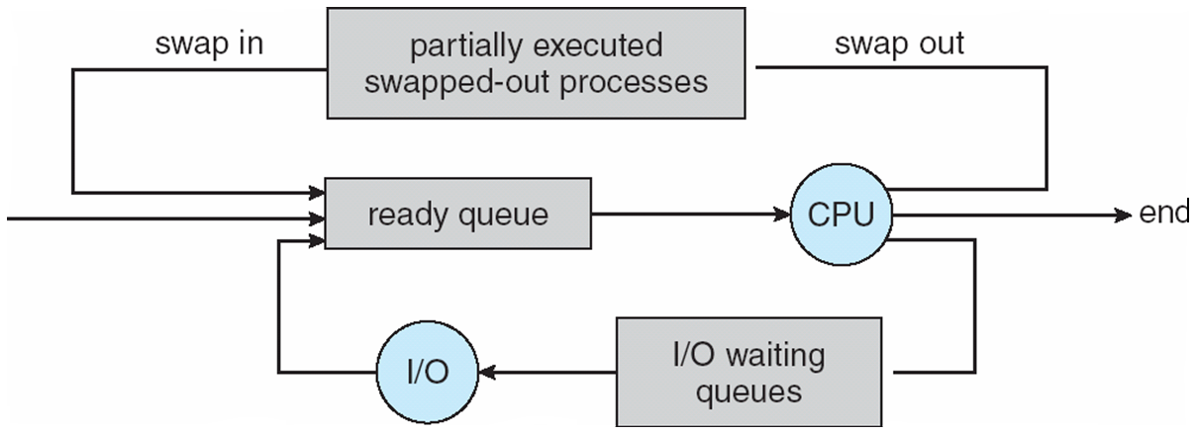
Addition of Medium Term Scheduling
Medium-term scheduler can be added if degree of multiple programming needs to decrease
Remove process from memory, store on disk, bring back in from disk to continue execution: swapping
Notes:
Medium-term:
putting processes into ready queue (?)
*look over this later

Slide 16
Context Switch
When CPU switches to another process, the system must save the state of the old process and load the saved state for the new process via a context switch
Context of a process represented in the PCB
Context-switch time is overhead; the system does no useful work while switching
The more complex the OS and the PCB ➔ the longer the context switch
Time dependent on hardware support
Some hardware provides multiple sets of registers per CPU ➔ multiple contexts loaded at once
Notes:
When switching processes:
- save the state
- load next
context switch – PCB
overhead cost time, no useful processing during this time
more complex OS/PCB == longer switching
How often you should be switching is dependent on application
server = less frequent switching, it is more important to complete the processing
touchscreen = more frequent switching, more important for user to feel like the performance is good

Slide 17
Operations on Processes
System must provide mechanisms for:
process creation,
process termination,
and so on as detailed next

Slide 18
Process Creation
Parent process create children processes, which, in turn create other processes, forming a tree of processes
Generally, process identified and managed via a process identifier (pid)
Resource sharing options
Parent and children share all resources
Children share subset of parent’s resources
Parent and child share no resources
Execution options
Parent and children execute concurrently
Parent waits until children terminate
Notes:
Pid – process identifier
Parent and children execute concurrently

Slide 19
A Tree of Processes in Linux

Slide 20
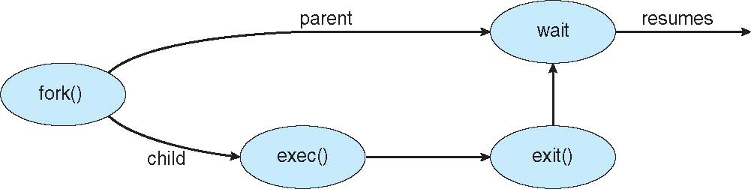
Process Creation (Cont.)
Address space
Child duplicate of parent
Child has a program loaded into it
UNIX examples
fork() system call creates new process
exec() system call used after a fork() to replace the process’ memory space with a new program
Notes:
Create a process using fork

Slide 21
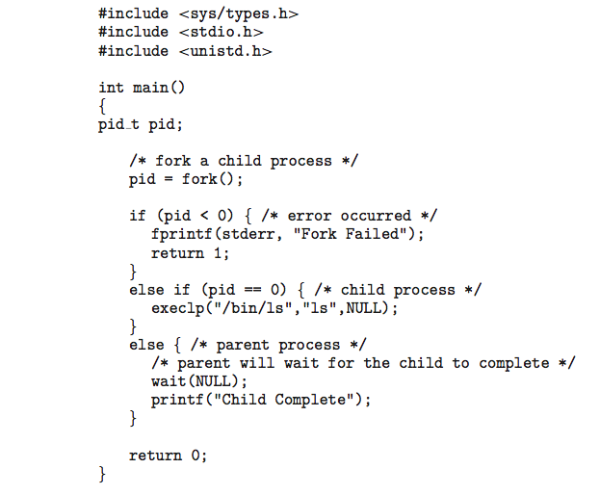
C Program Forking Separate Process

Slide 22
Process Termination
Process executes last statement and then asks the OS to delete it using the exit() system call.
Returns status data from child to parent (via wait())
Process’ resources are deallocated by OS
Parent may terminate the execution of children processes using the abort() system call. Some reasons for doing so:
Child has exceeded allocated resources
Task assigned to child is no longer required
The parent is exiting and the operating systems does not allow a child to continue if its parent terminates

Slide 23
Process Termination
Some operating systems do not allow child to exist if its parent has terminated. If a process terminates, then all its children must also be terminated.
cascading termination. All children, grandchildren, etc. are terminated.
The termination is initiated by the operating system.
The parent process may wait for termination of a child process by using the wait()system call. The call returns status information and the pid of the terminated process
pid = wait(&status);
If no parent waiting (did not invoke wait()) process is a zombie
If parent terminated without invoking wait , process is an orphan

Slide 24

Multiprocess Architecture – Chrome Browser
Many web browsers ran as single process (some still do)
If one web site causes trouble, entire browser can hang or crash
Google Chrome Browser is multiprocess with 3 different types of processes:
Browser process manages user interface, disk and network I/O
Renderer process renders web pages, deals with HTML, Javascript. A new renderer created for each website opened
Runs in sandbox restricting disk and network I/O, minimizing effect of security exploits
Plug-in process for each type of plug-in

Slide 25
Interprocess Communication
Processes within a system may be independent or cooperating
Cooperating process can affect or be affected by other processes, including sharing data
Reasons for cooperating processes:
Information sharing
Computation speedup
Modularity
Convenience
Cooperating processes need interprocess communication (IPC)
Two models of IPC
Shared memory
Message passing

Slide 26
Communications Models
(a) Message passing. (b) shared memory.

Slide 27
Cooperating Processes
Independent process cannot affect or be affected by the execution of another process
Cooperating process can affect or be affected by the execution of another process
Advantages of process cooperation
Information sharing
Computation speed-up
Modularity
Convenience

Slide 28
Producer-Consumer Problem
Paradigm for cooperating processes, producer process produces information that is consumed by a consumer process
unbounded-buffer places no practical limit on the size of the buffer
bounded-buffer assumes that there is a fixed buffer size

Slide 29
Bounded-Buffer – Shared-Memory Solution
Shared data
#define BUFFER_SIZE 10
typedef struct {
. . .
} item;
item buffer[BUFFER_SIZE];
int in = 0;
int out = 0;
Solution is correct, but can only use BUFFER_SIZE-1 elements

Slide 30
Bounded-Buffer – Producer
item next_produced;
while (true) {
/* produce an item in next produced */
while (((in + 1) % BUFFER_SIZE) == out)
; /* do nothing */
buffer[in] = next_produced;
in = (in + 1) % BUFFER_SIZE;
}

Slide 31
Bounded Buffer – Consumer
item next_consumed;
while (true) { while (in == out)
; /* do nothing */ next_consumed = buffer[out];
out = (out + 1) % BUFFER_SIZE;
/* consume the item in next consumed */
}

Slide 32
Interprocess Communication – Shared Memory
An area of memory shared among the processes that wish to communicate
The communication is under the control of the users processes not the operating system.
Major issues is to provide mechanism that will allow the user processes to synchronize their actions when they access shared memory.
Synchronization is discussed in great details in Chapter 5.

Slide 33
Interprocess Communication – Message Passing
Mechanism for processes to communicate and to synchronize their actions
Message system – processes communicate with each other without resorting to shared variables
IPC facility provides two operations:
send(message)
receive(message)
The message size is either fixed or variable

Slide 34
Message Passing (Cont.)
If processes P and Q wish to communicate, they need to:
Establish a communication link between them
Exchange messages via send/receive
Implementation issues:
How are links established?
Can a link be associated with more than two processes?
How many links can there be between every pair of communicating processes?
What is the capacity of a link?
Is the size of a message that the link can accommodate fixed or variable?
Is a link unidirectional or bi-directional?

Slide 35
Direct Communication
Processes must name each other explicitly:
send (P, message) – send a message to process P
receive(Q, message) – receive a message from process Q
Properties of communication link
Links are established automatically
A link is associated with exactly one pair of communicating processes
Between each pair there exists exactly one link
The link may be unidirectional, but is usually bi-directional

Slide 36
Synchronization
Message passing may be either blocking or non-blocking
Blocking is considered synchronous
Blocking send -- the sender is blocked until the message is received
Blocking receive -- the receiver is blocked until a message is available
Non-blocking is considered asynchronous
Non-blocking send -- the sender sends the message and continue
Non-blocking receive -- the receiver receives:
A valid message, or
Null message
Different combinations possible
If both send and receive are blocking, we have a rendezvous

Slide 37
Synchronization (Cont.)
Producer-consumer becomes trivial
message next_produced;
while (true) { /* produce an item in next produced */
send(next_produced);
}
message next_consumed;
while (true) {
receive(next_consumed);
/* consume the item in next consumed */
}

Slide 38
Communications in Client-Server Systems
Sockets
Remote Procedure Calls
Pipes
Remote Method Invocation (Java)

Slide 39
Sockets
A socket is defined as an endpoint for communication
Concatenation of IP address and port – a number included at start of message packet to differentiate network services on a host
The socket 161.25.19.8:1625 refers to port 1625 on host 161.25.19.8
Communication consists between a pair of sockets
All ports below 1024 are well known, used for standard services
Special IP address 127.0.0.1 (loopback) to refer to system on which process is running

Slide 40
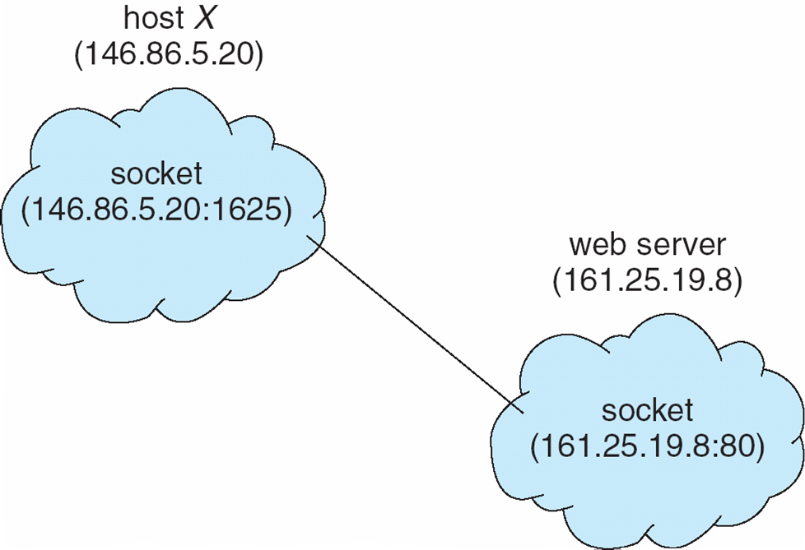
Socket Communication

Slide 41
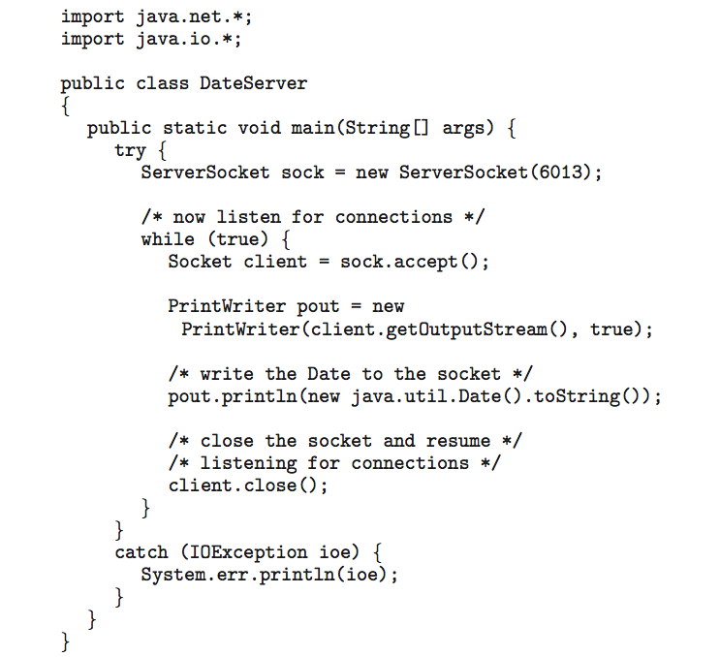
Sockets in Java
Three types of sockets
Connection-oriented (TCP)
Connectionless (UDP)
MulticastSocket class– data can be sent to multiple recipients
Consider this “Date” server:

Slide 42
End of Chapter 3

